Slide 1
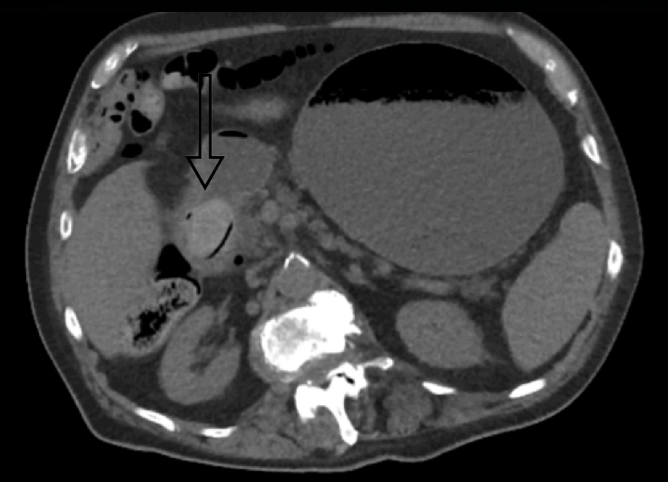
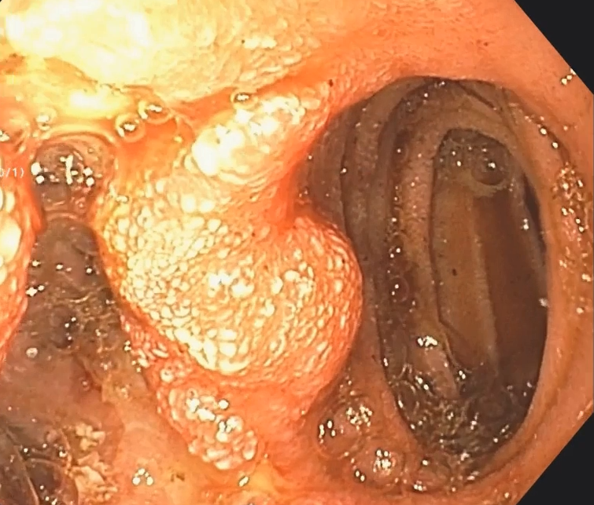
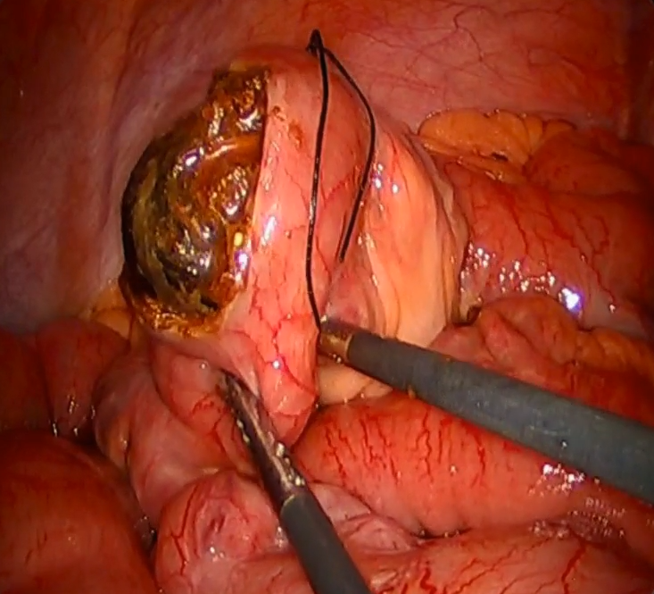
Endoscopic & Laparoscopic Management
of a Case of Bouveret Syndrome
CT showing a gallstone lodged in the second portion of the duodenum causing a gastric outlet obstruction
Esophagogastroduodenoscopy displaying the presence of a cholecystoduodenal fistula
Laparoscopic view of the
enterolithotomy revealing the gallstone
Figures, tables etc
Figures, tables etc
Figures, tables etc
Figures, tables etc
Citation: Horsley, RD, SAGES 2019. April 2019

