Slide 1
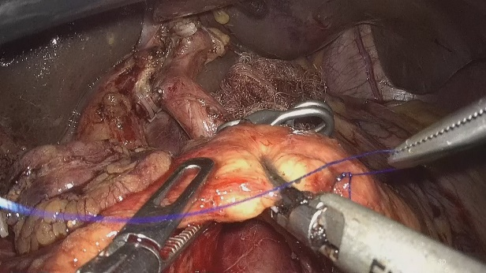
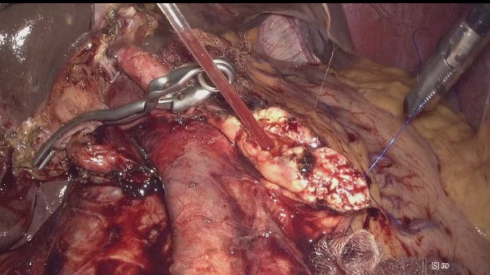
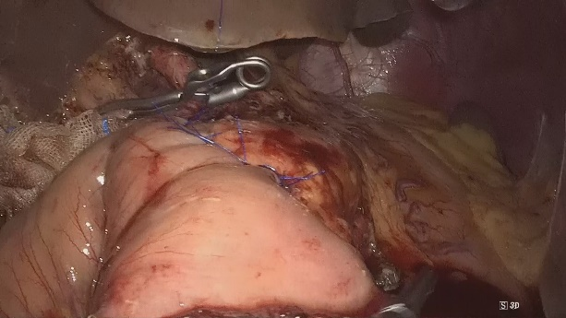
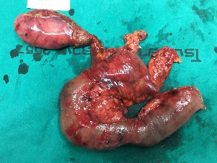
Total Laparoscopic Pancreaticoduodenectomy
BMA General Hospital
Figures, tables etc
Dissection
Anatomy
Reconstruction
Narong Boonyagard MD.
BMA General hospital
Thailand

