Slide 1
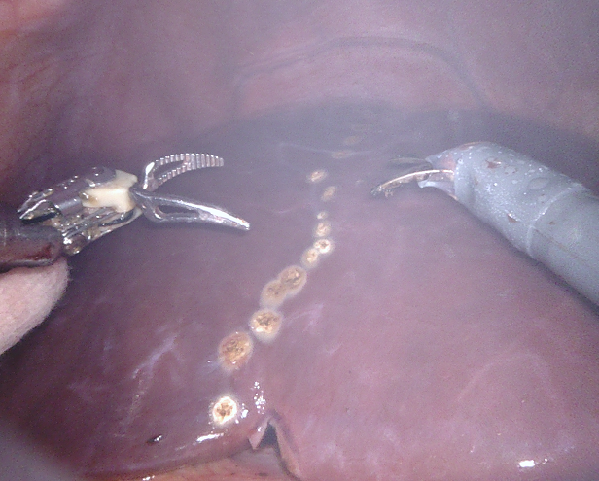
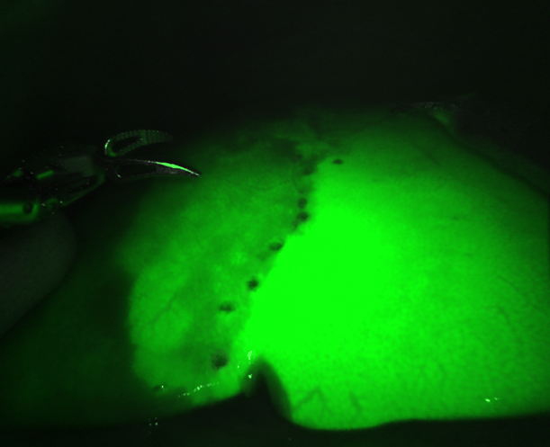
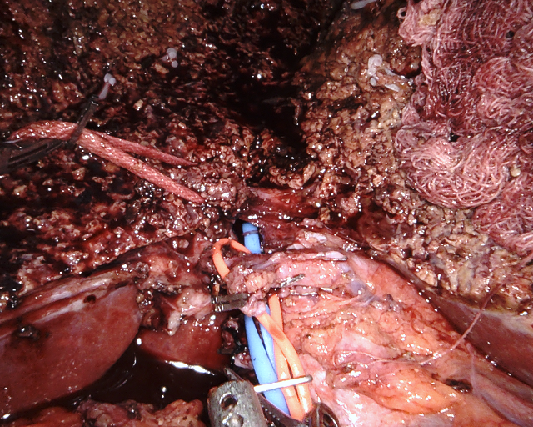
Robotic Living Donor Hepatectomy
Demarcation of liver lobes enhanced with ICG Firefly® technology
Meticulous parenchymal transection with superior 3D visualization
Plenary II session
Saturday, April 6
1100
Jaekeun Kim, Yee Lee Cheah, Caroline J Simon, Mohamed E Akoad

