Slide 1
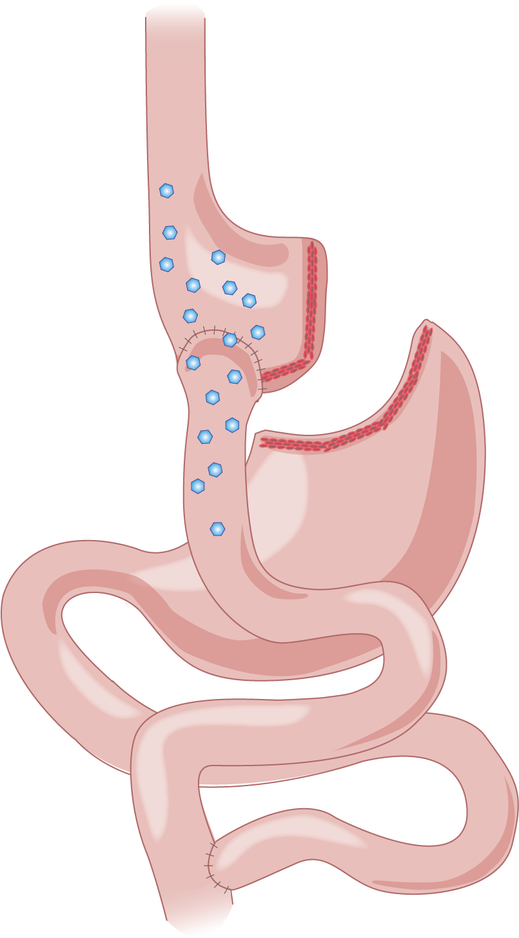
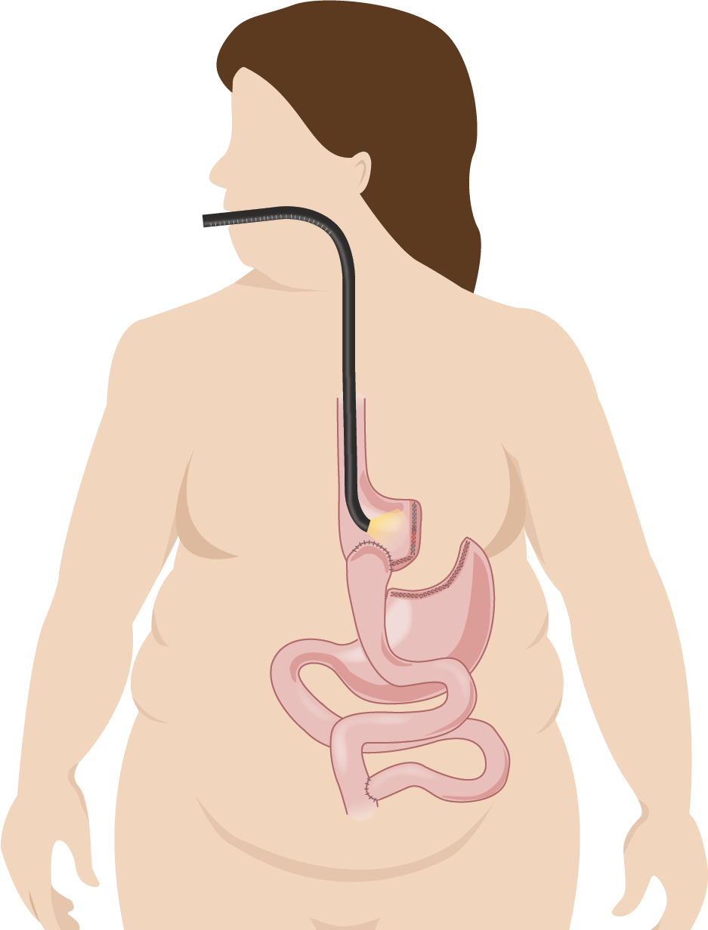
Endoscopic gastro-jejunal revisions for treatment of dumping syndrome after Roux-en-Y gastric bypass
Symptomatic response rate: 89.2%
Sigstad score: 13.9 → 8.6
Some patients will need repeat intervention for symptom control
22.5%
(Required repeat endoscopic intervention)
Effective treatment option for dumping syndrome
Feasible and safe procedure
0
(No 30-day bleeding,
re-intervention, dilation)
N=40
Figures, tables etc
Citation: Tsai, Surg Endo. April 2019

