Slide 1
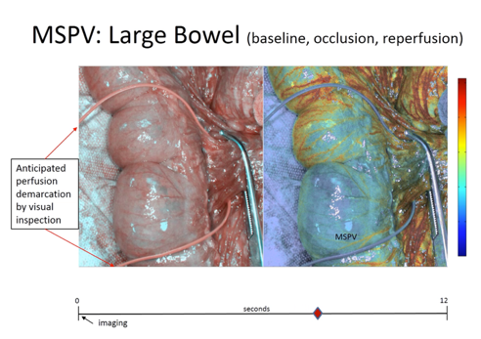
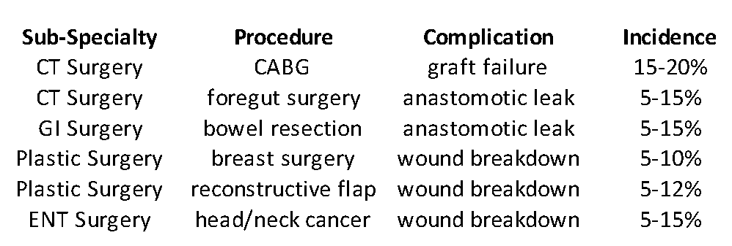
Tissue Perfusion Data in Real-Time During Surgery:
A Revolutionary New Medical Imaging Technology
Most major complications across surgical specialties and procedures are due to an unrecognized compromise in tissue integrity involving abnormal perfusion.
Surgeons haven’t been able to see blood flow, so they must ‘guess’ → 10-15% error rate.¹
Multi-spectral Physiologic Visualization (MSPV) images and relatively quantifies the physiology of blood flow distribution – flow and perfusion -- in true real-time during surgery.²⁻⁴
MSPV is non-invasive, non-contact, has no ionizing radiation, and use isn’t disruptive to the surgical procedure.
MSPV’s analysis augments the standard of care for surgical decision-making.
FDA Class II 510(k) approved ‘iCertainty’ is coming to Operating Room Suites in Q3, 2019.
Figures, tables etc
Citation:
¹Bornstein et al (2018). J Surg Res 232:179-185
²Ferguson TB et al. US Patent # 9,226,673. Jan 5, 2016
³Ferguson TB et al. US Patent # 9,271,658 Mar 8, 2016
⁴Chen C et al. US Patent # 10,058,256, Aug 28, 2018
Contact: Jeff Basham, CEO; 919-280-2953
Jeff.basham@rfpi-co.com; http://www.rfpi-co.com

